Slide 1
CI/CD for PowerShell That Isn’t a Mess
Thomas Rayner

Slide 2
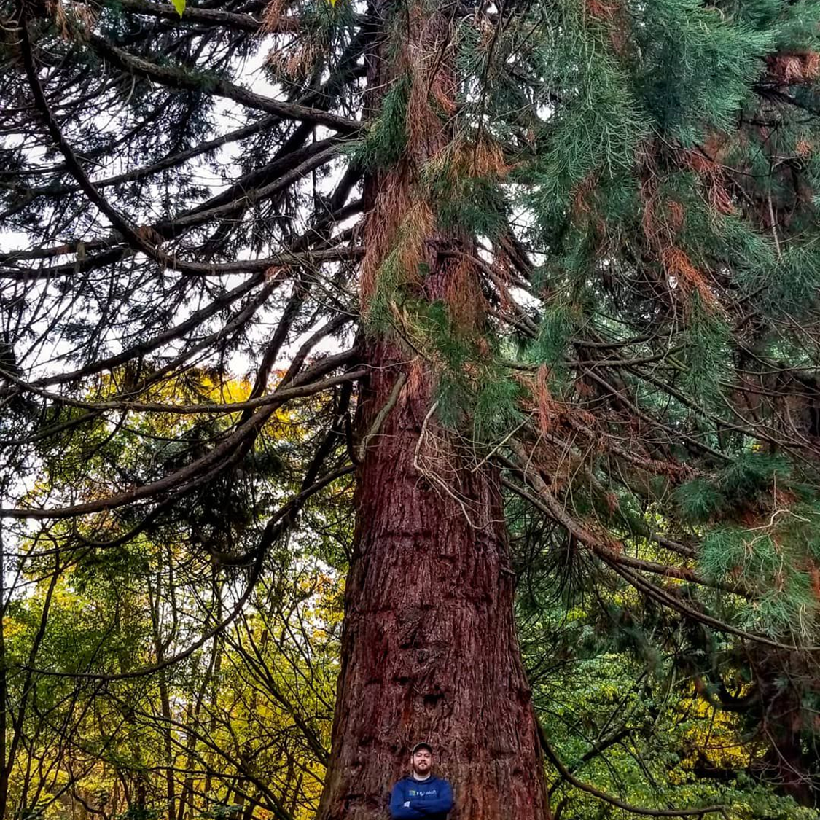
Thomas Rayner
Certified Information Systems Security Professional (CISSP)
Sr Security Service Engineer @ Microsoft
@MrThomasRayner
thomasrayner.ca | PowerShell Discord/Slack aka.ms/psdiscord aka.ms/psslack
github.com/thomasrayner | pluralsight.com/authors/thomas-rayner

Slide 3


Nothing is easy, but You can do this

Slide 4
Why? Like, Who cares?

Slide 5





Things That Might Be Written In PowerShell (Food For Thought)
CI/CD scripts
Help Desk tools
Login scripts
Ops team utilities (huge rabbit hole)
Cloud management scripts

Slide 6
The benefits of CI/CD that you appreciate for your apps and services also apply to the things that are written in PowerShell

Slide 7






What qualifies as “a mess”?
No tests
No signing
No linting
No peer review
No difference between source and deployed artifacts
No approval consideration
No dev environment

Slide 8
So, what do you actually do?

Slide 9


The Basics
Stored in source control
Peer reviews
Approval workflow

Slide 10






Build Stuff
I thought PowerShell was interpreted, not compiled?
Modules
Performance counts
Assembling deployable artifacts

Slide 11



Test Stuff
PSScriptAnalyzer
Pester
VS Code PowerShell Ext
Static code analysis
github.com/powershell/psscriptanalyzer
Test and mock framework
github.com/pester/pester
Includes PSSA!
github.com/powershell/vscode-powershell
Notes:
PSSA rules for
Formatting and style
Security
Obsolescence
Pester works on Linux
Xplat testing

Slide 12
Sign Stuff
$items = (Get-ChildItem $Path -Recurse | Where-Object {
-not $_.PsIsContainer -and
(".ps1", ".psm1", ".psd1", ".ps1xml", ".dll", ".exe" -contains $_.Extension)
}).FullName
foreach ($item in $items) {
Set-AuthenticodeSignature -Certificate $signingCert -FilePath $item
}

Slide 13



Deploy Stuff
File share (if you must)
Sysvol
User workstations
Nuget feed
PowerShell gallery
Internal system
Azure Artifacts
To the cloud
Any cloud at all

Slide 14
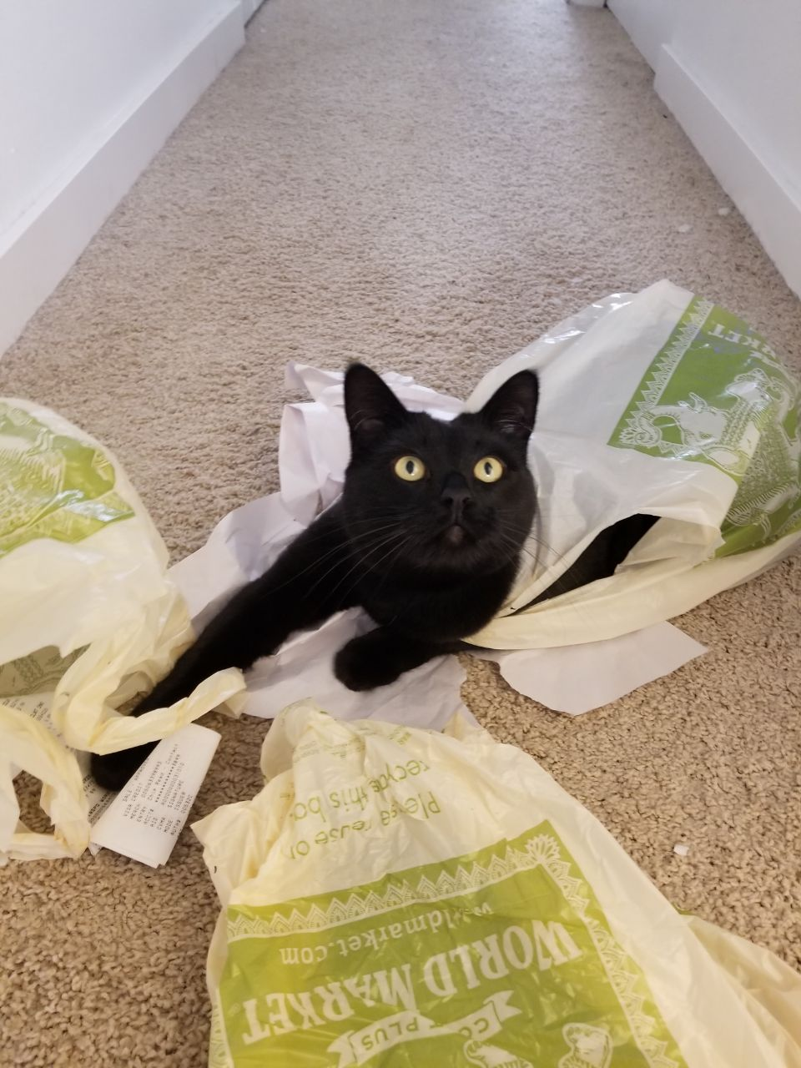
Helpers

Slide 15
Helpers
Invoke-Build
Psake
Plaster
Configuration
PSDepend
Platyps
Notes:
Tons of platforms
Azure DevOps
GitHub Actions
etc.

Slide 16






Avoiding The Mess
Cover the basics
Source control
Peer review
Approvals
Building
Performance
Isolate deployable artifacts
Testing
PSScriptAnalyzer
Pester
Deploying
Anywhere you want to be
Helpers
Countless tools available

Slide 17
Thank you!
Thomas Rayner
Certified Information Systems Security Professional (CISSP)
Sr Security Service Engineer @ Microsoft
@MrThomasRayner

